Slide 1

EVPN - Connection
MobiCom
2024-2-21

Slide 2

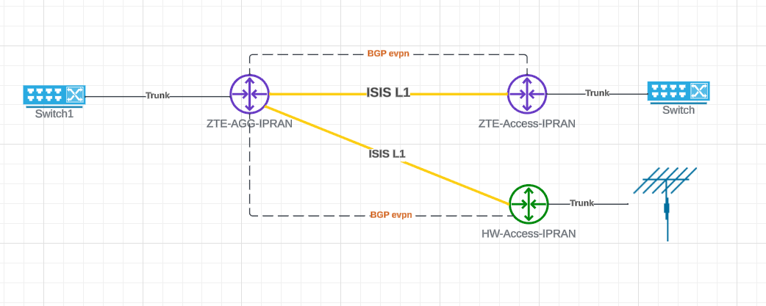
Topology

Slide 3
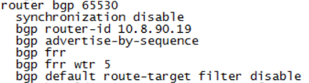
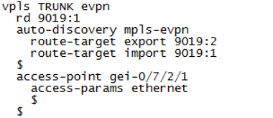

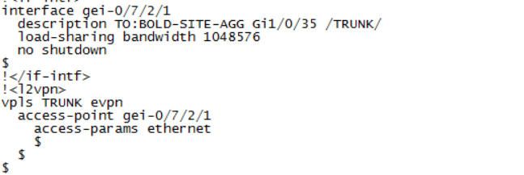
Configuration of SITE-AGG ZTE-9k
SITE-AGG BGP session
VPLS-EVPN Circuit
Interface port and Vpls-Evpn
Interface Status

Slide 4
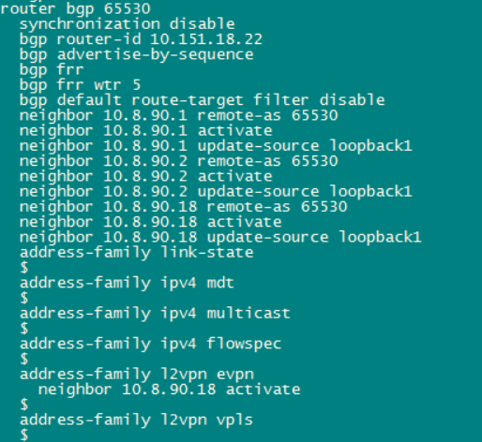
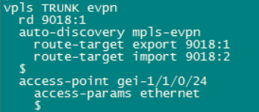
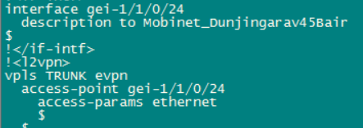
Topology
BGP session
VPLS-EVPN Circuit
Interface port and Vpls-Evpn

Slide 5
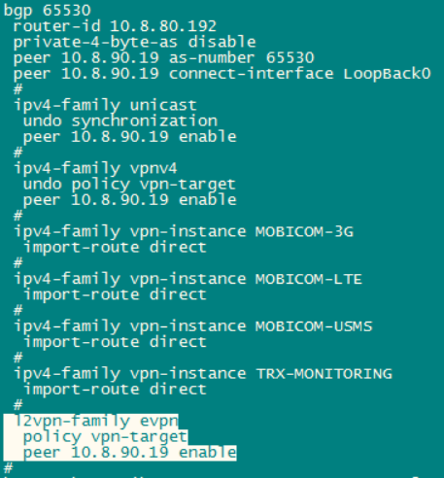



Configuration of HuaweiATN910
BGP session
VPLS-EVPN Circuit
Interface port and Vpls-Evpn

Slide 6
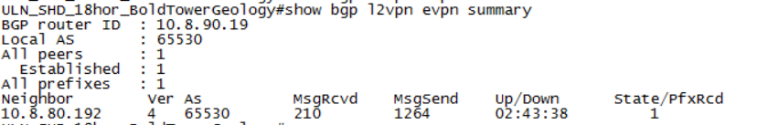
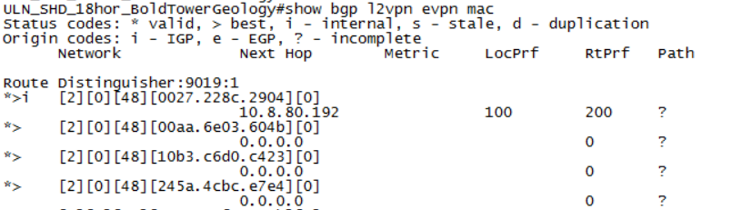
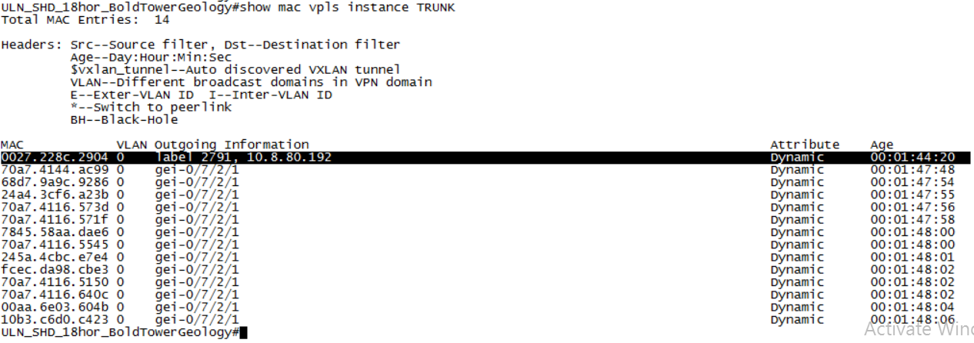
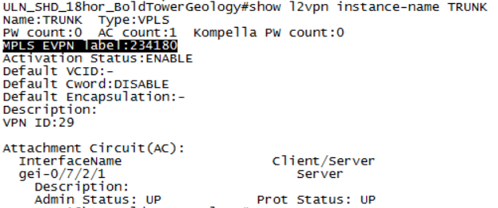
Check evpn on ZTE9k

Slide 7
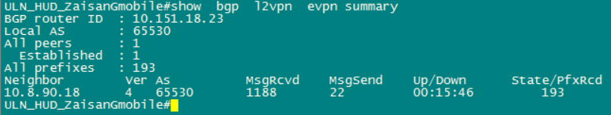
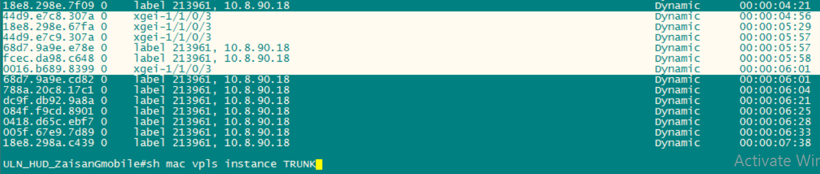
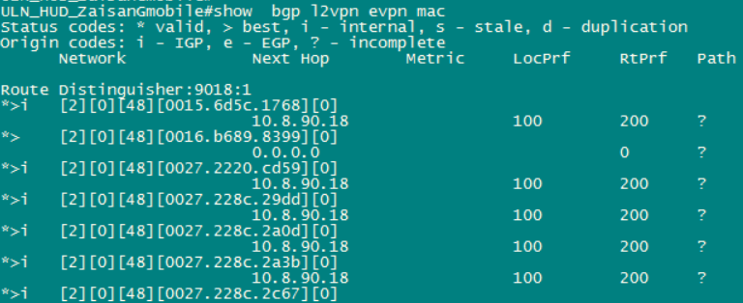
Check evpn on ZTE-IPRAN ACCESS
BGP evpn session
Mac Check
Mac routing table

Slide 8
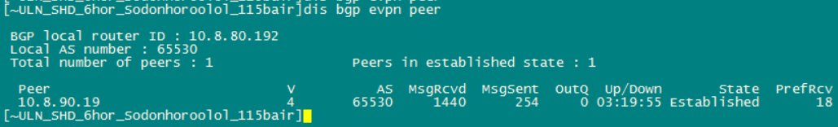
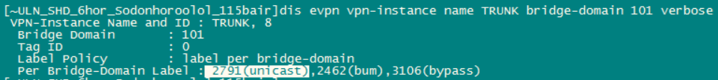
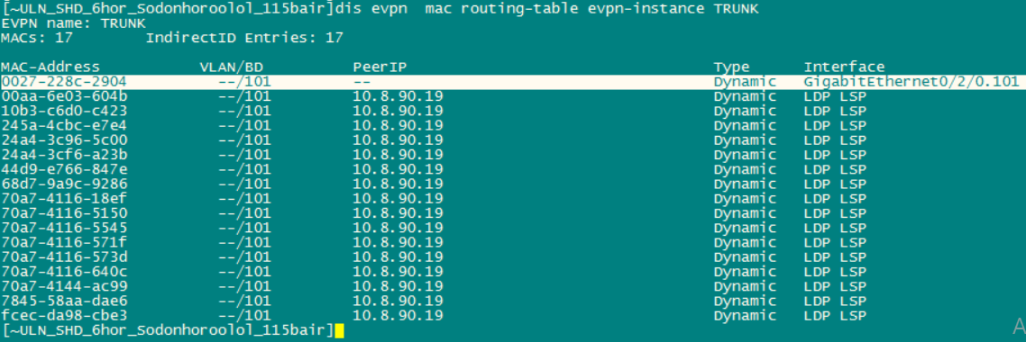
Check evpn on HuaweiATN910
BGP evpn session
Bridge domain label
Mac routing table

Slide 9
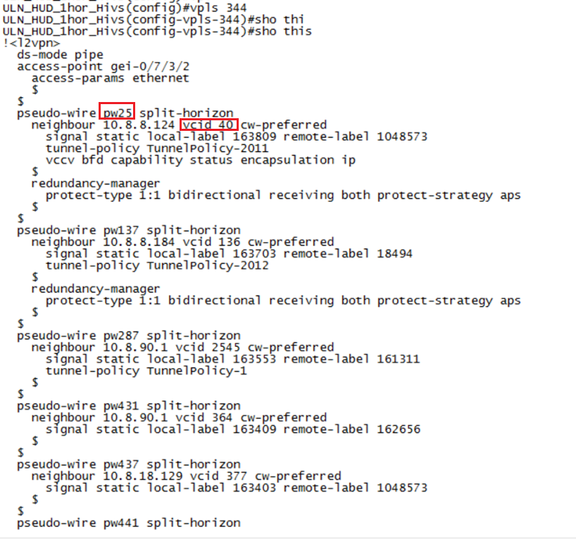
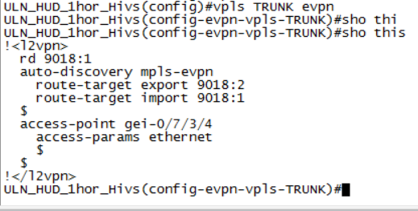
L2 vpls configuration
Evpn vpls configuration

Slide 11

THANK YOU!

